Slide 1
Group – 7 IPL 2008-2019 Prediction Model
Group members :
Mishit Shah
Chinmay Shukla
Prathamesh Teli
Gaurav Sharma
Datta sai krishna Naidu

Slide 2
Problem Statement :
The IPL prediction Model is all about the Analysis of the Dataset IPL 2008 – 2019
Through this dataset we aim to build a model to find out the Predicted score after each delivery, similarly the Best Batsman, Best Bowler and compare this with the actual statistics

Slide 3
About the Dataset :
The Dataset for the IPL 2008 – 2019 is retrieved from the Kaggle
Command :
kaggle datasets download -d nowke9/ipldata
Website:
https://www.kaggle.com/datasets/nowke9/ipldata
The data set contains two files & Data till Season 11 (2008 - 2019)
matches.csv - Match by match data
deliveries.csv - Ball by ball data

Slide 4
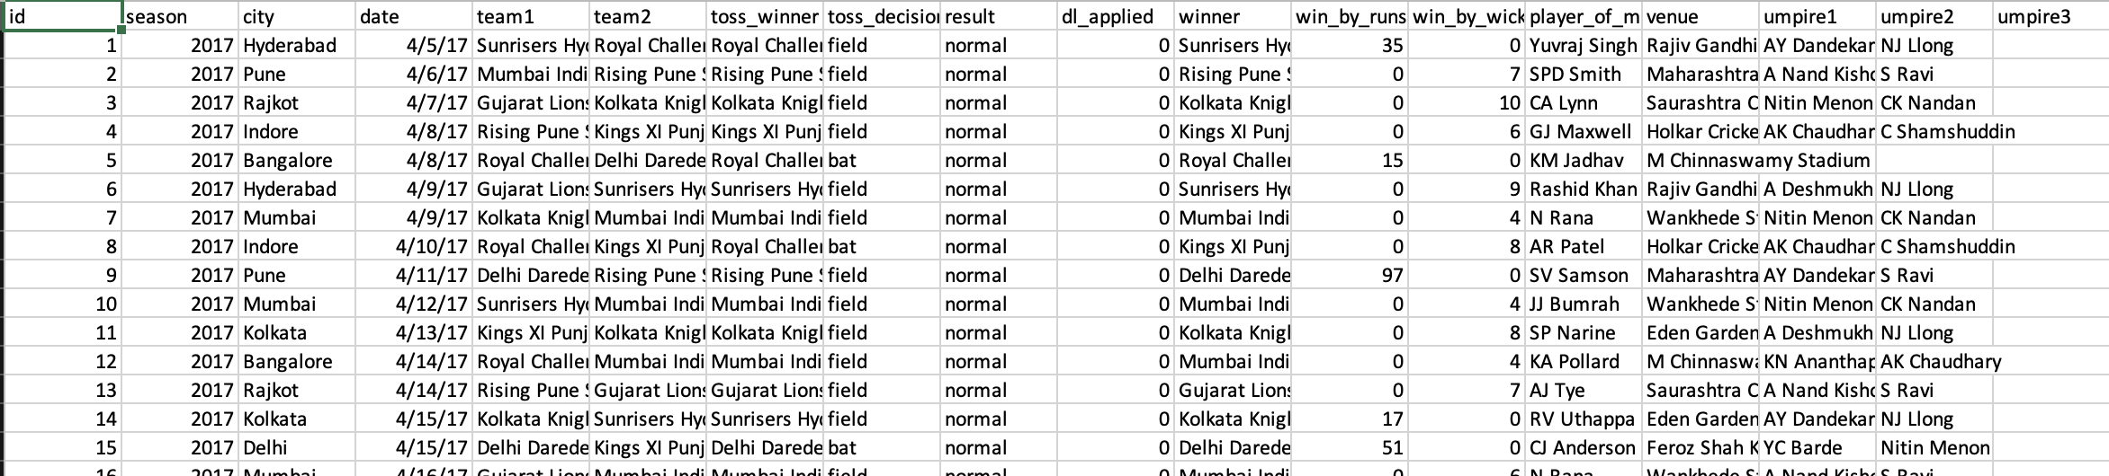
About Matches.csv :
Total number of columns : 18
No null value column's

Slide 5
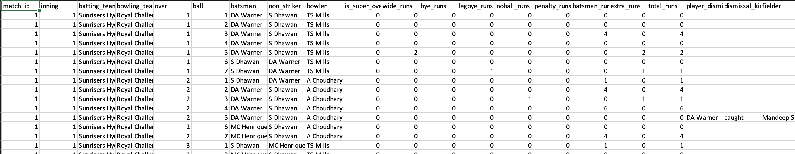
About Deliveries.csv :
Data source from 2008-2017 - CricSheet.org and Manas - Kaggle
Data source for 2018-2019 - IPL T20 - Official website
Total number of columns : 21
No null value column's

Slide 6
Preprocessing of Data :
Since there are Null values most of the data from columns can be used to find out the results
The dataset has total of 39 columns (including both files) with information on the match venue, club names, player names, scores, and results, and 756 rows with each row representing a different IPL contest.
The dataset’s main features include Data categories, no lacking values etc. Overall, the dataset is well-prepared and suitable for different IPL match related analytics and modeling tasks.

Slide 7
Methodology :
Since this is a regression model, we are unable to use classification metrics; as a substitute, we frequently use Mean Squared Error (MSE), Root Mean Squared Error (RMSE), R-squared (R2), and Explained Variance Score (EVS) as success metrics for regression issues. Mean Squared Error (MSE), Root Mean Squared Error (RMSE), Rsquared (R2), and Explained Variance Score are frequently used performance measures for regression issues. (EVS).

Slide 8
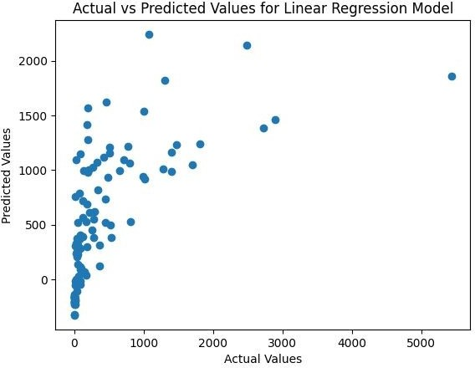
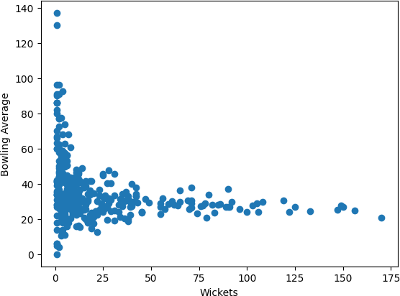
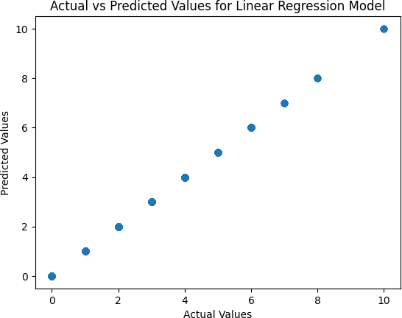
CONCLUSION

Slide 9
FUTURE SCOPE
Enhanced Player Performance Projections
Real-time Data Integration
Customization and Personalization
Incorporation of Advanced Metrics
Integration of Artificial Intelligence
Expansion to New Sports and Leagues

